Slide 1
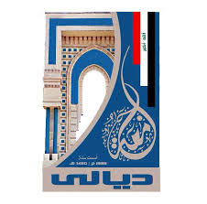
Electrical Circuit-I
5th Lecture

